Slide 1
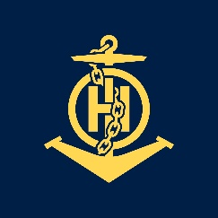
IHO – NIPPON FOUNDATION
ALUMNI SEMINAR
YULIIA NEZHURENKO

Slide 2
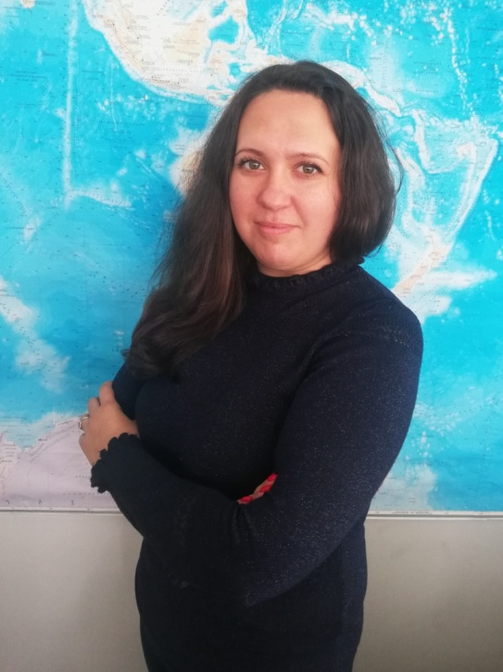
Self introduction
IHO – NIPPON FOUNDATION
ALUMNI SEMINAR
Name | Yuliia Nezhurenko
Alumni year | 2017
Country | Ukraine
Organization | State Hydrographic Service of Ukraine (SHSU)
Position/Job title | 1st Category Cartographer
Current job description | Charts digitizing and maps original layout processing, preparing for edition of the electronic nautical charts (ENC), plans and charts of inland waterways, including development of appropriate schemes and tables; other Cartographers’ results checking; new methods of work presentation for the personnel of the department, teaching co-workers to modern effective methods of work; quality control of preparatory work before digitizing nautical charts and plans; ready digital sets checking and testing; current proof of ENCs and plans and charts of inland waterways; studying materials of hydrographic surveying in order to develop and update the nautical charts and hydrographic surveying data base creation.
Please put your photo here!

Slide 3
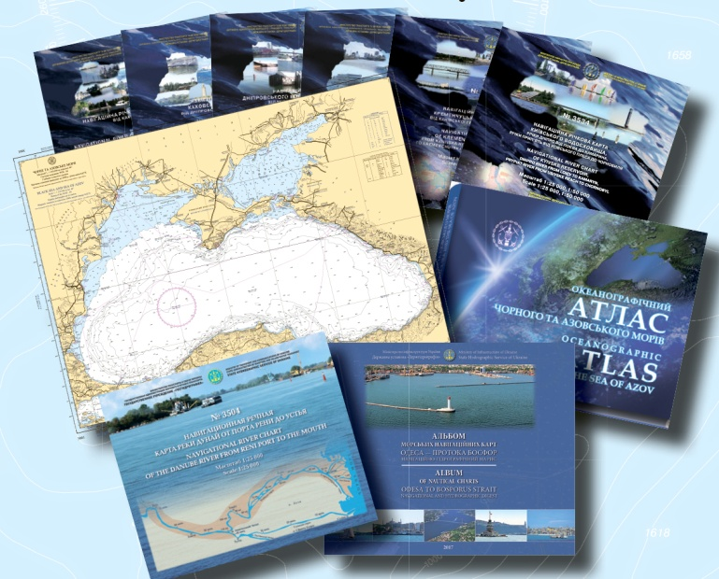
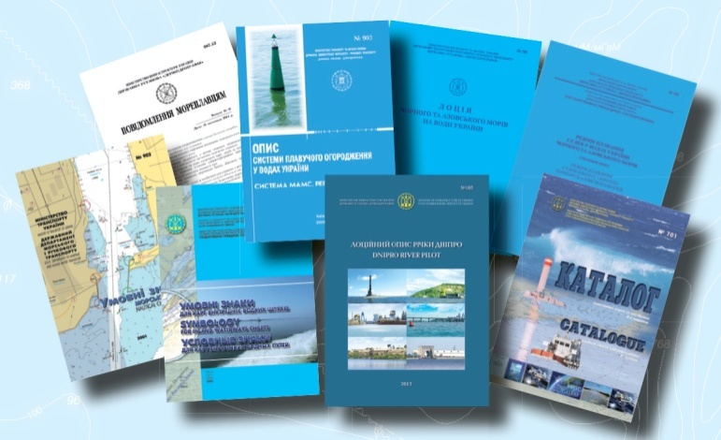
My career path and projects / Achievements
IHO – NIPPON FOUNDATION
ALUMNI SEMINAR
SHSU produces
Nautical Charts
River Navigational Charts
ENC Cells
Notices to Mariners
Guides and Nautical Publications etc

Slide 4
My career path and projects / Achievements
IHO – NIPPON FOUNDATION
ALUMNI SEMINAR
My experience and some of projects I was involved in, -
Hydrographic surveying data processing and analyzing
Topographic and satellite derived data processing
Electronic nautical charts and paper charts compilation
Chart 3203 “Karkinitska Gulf”
Scale 1 : 200 000
Chart 3401 “Approaches to Zhebriianska Bay”
Scale 1 : 50 000
Chart 3405 “Ochakiv to Pivdennyi Buh River”
Scale 1 : 50 000
All charts meet the updating requirements by providing timely updates

Slide 5
3203 “Karkinitska Gulf” Scale 1 : 200 000
IHO – NIPPON FOUNDATION
ALUMNI SEMINAR

Slide 6
3401 “Approaches to Zhebriianska Bay” Scale 1 : 50 000
IHO – NIPPON FOUNDATION
ALUMNI SEMINAR

Slide 7
3405 “Ochakiv to Pivdennyi Buh River” Scale 1 : 50 000
IHO – NIPPON FOUNDATION
ALUMNI SEMINAR

Slide 8
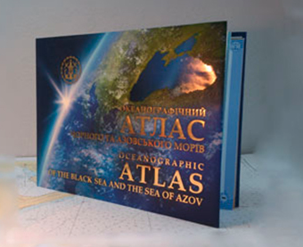
IHO – NIPPON FOUNDATION
ALUMNI SEMINAR
Participation in working on “Oceanographic Atlas of the Black Sea and the Sea of Azov” issued in 2009

Slide 9
Oceanographic Atlas of the Black Sea and the Sea of Azov
IHO – NIPPON FOUNDATION
ALUMNI SEMINAR

Slide 10
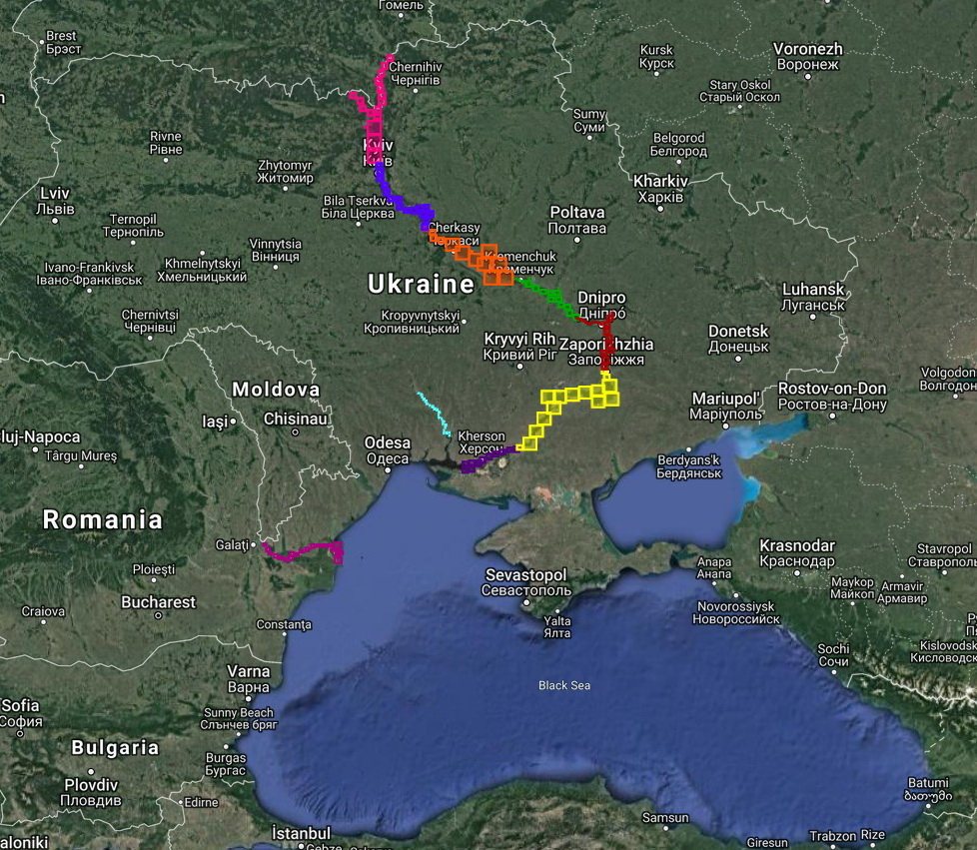
IHO – NIPPON FOUNDATION
ALUMNI SEMINAR
River Navigational Charts of Ukraine

Slide 11
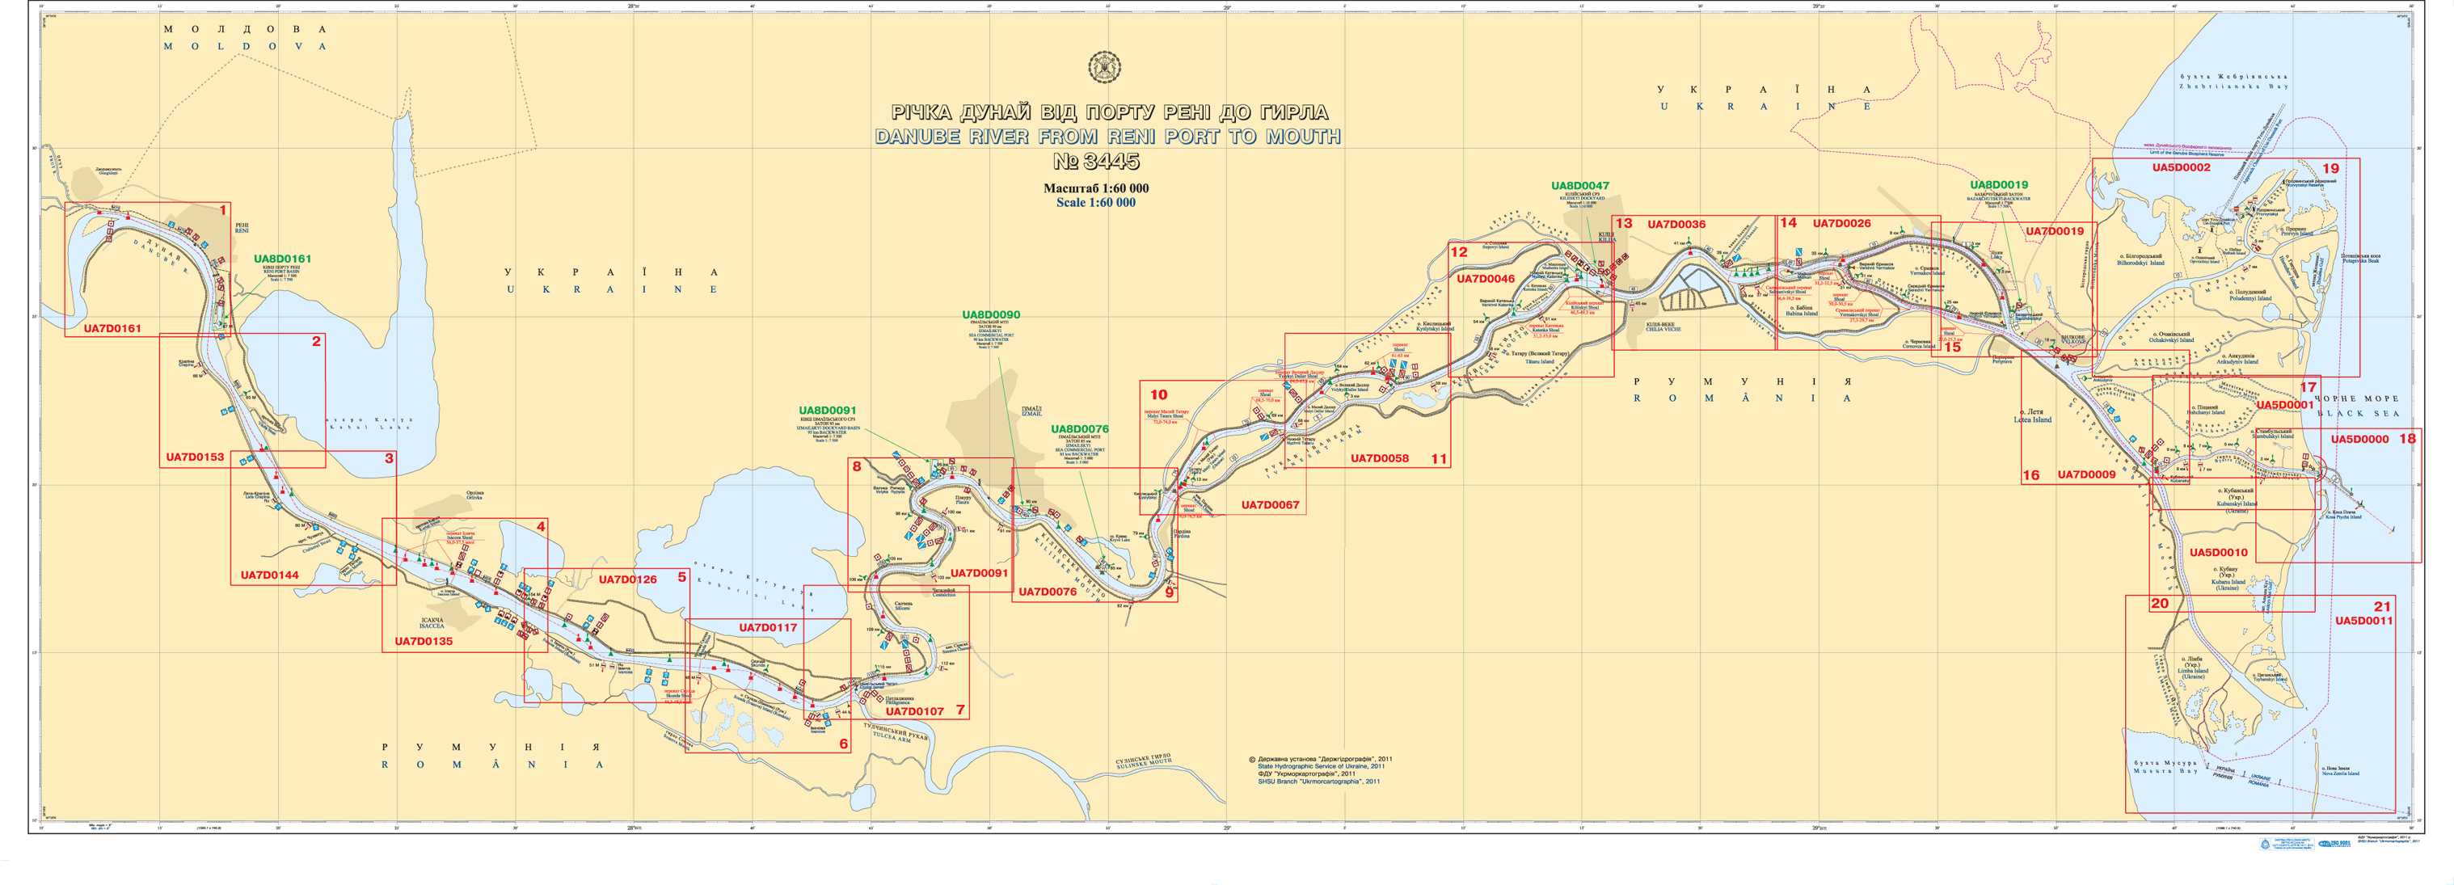
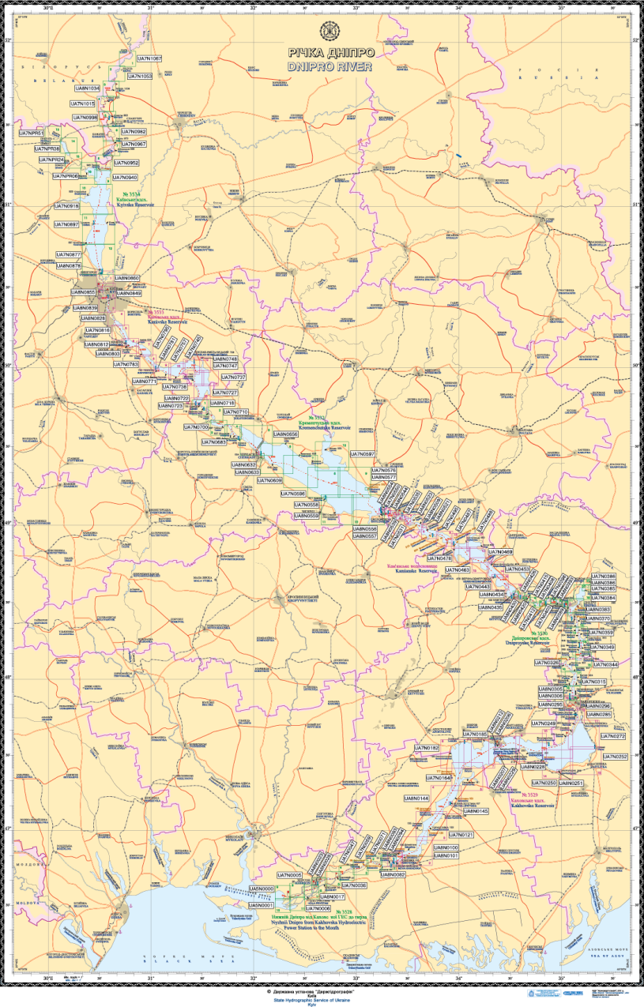
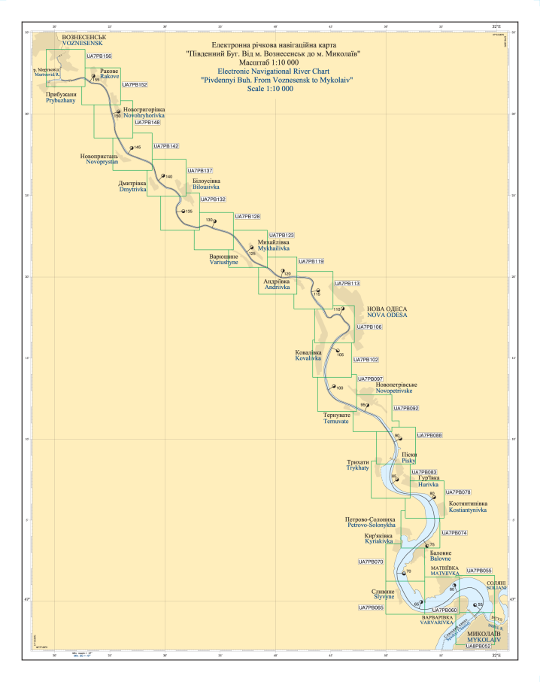
Danube River
Dnipro River
Pivdennyi Buh River

Slide 12
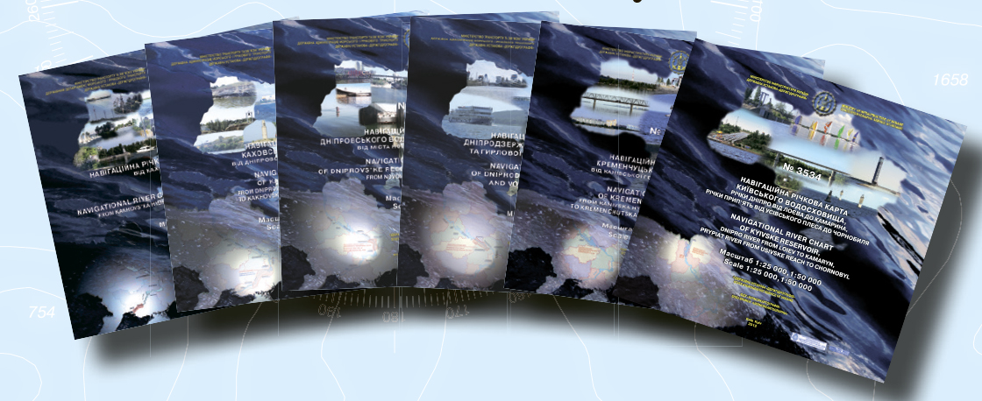
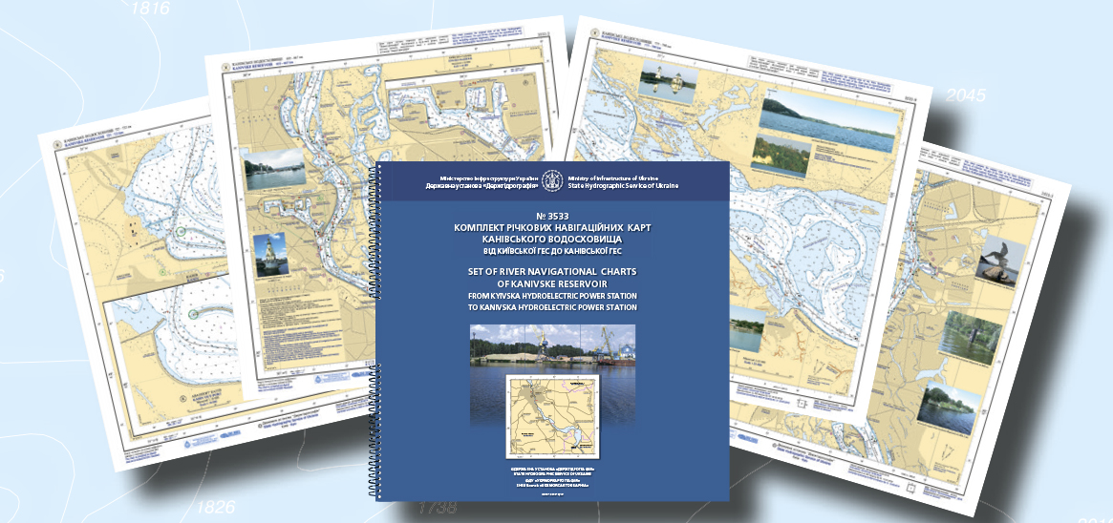
Transition from River Navigational Chart Albums to Sets of River Navigational Charts

Slide 13
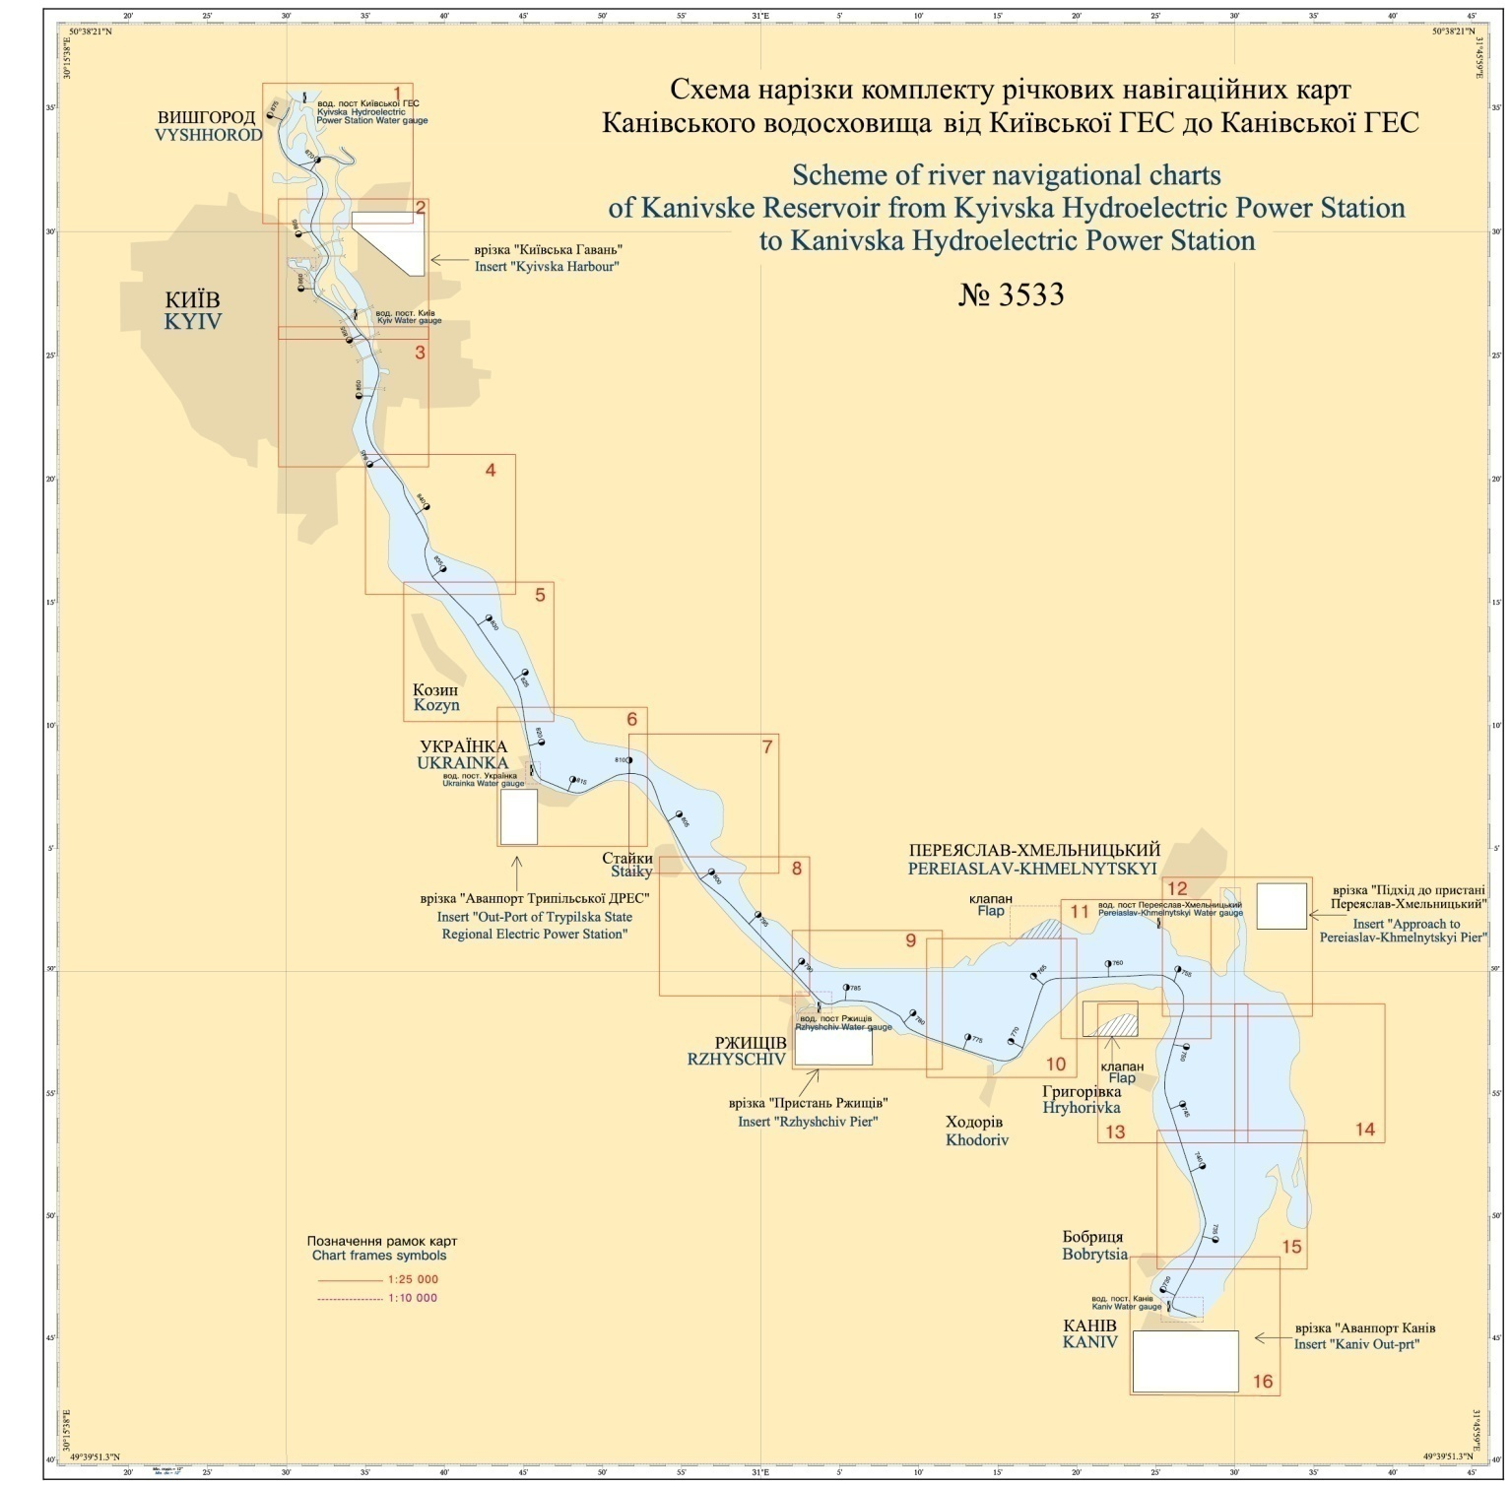
Set of River Navigational Charts No. 3533 of Kanivske Reservoir from Kyivska Hydroelectric Power Station to Kanivska Hydroelectric Power Station (16 sheets)

Slide 14
Lessons learned from CHART Course
IHO – NIPPON FOUNDATION
ALUMNI SEMINAR
Benefits that I received from the course -
Extending my skills in the nautical cartography
Got modern knowledge connected to my work
Became much more confident in decision-making about cartographic issues
Studied fundamentals of charting

Slide 15
Lessons learned from CHART Course
IHO – NIPPON FOUNDATION
ALUMNI SEMINAR
The opportunity to study in depth the international standards for compilation nautical charts
CARIS S-57 Composer and CARIS Paper Chart Composer software learning
Meeting new foreign colleagues and seeing how the UKHO works in my field
Applying the knowledge, which I got during the course, to my current work

Slide 16
Suggestion for the future
IHO – NIPPON FOUNDATION
ALUMNI SEMINAR
The CHART course provides excellent opportunities for cartographers and hydrographers from all over the word to get modern and important knowledge for creating good quality nautical charts according to the international standards.
Suggestions
Scope of the Capacity Building course extending and development
Involving more countries
Involving more cartographers and hydrographers to participate in the training

